Slide 1

Introduction to Probabilistic Soft Logic With a Vision of Using it on Internet of Things Applications
Ibri College of Technology
Information Technology Department
April 15, 2019

Slide 2
To Collaborate
Email: duhai.alshukaili@ibrict.edu.om
Git-Hub Repo: https://github.com/duhai-alshukaili/FIR2019

Slide 3
What is IoT?
An ecosystem that includes communication, applications, data, and analytics.

Slide 4
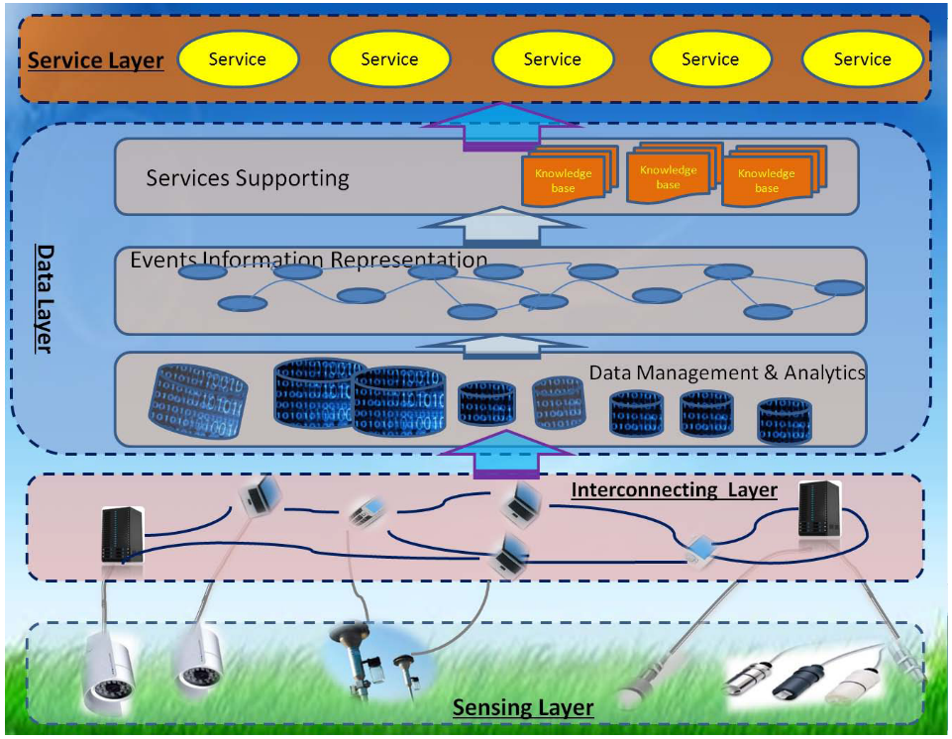
IoT Layered Architecture [Sun et al. 2016]

Slide 5
Argument
There is an inherent uncertainty that may arise in IoT Systems

Slide 6
Sensing Layer
Collect raw data from sensors
Sensors may fail to accurately sense the environment.
Electronic devices tend to fail over time [Jin, Wang and Huang, 2006]
You can not be entirely certain of data coming from this layer.

Slide 7
Interconnectivity Layer
Data transmission across devices
Security is an issue
Data are susceptible to change because of attacks [Schurgot, Shinberg and Greenwald, 2015]
Such attacks increases the uncertainty of the data in such networks

Slide 8
Data Layer
Storage and retrieval of heterogeneous data stemming from bottom two layers.
Machine learning to extract useful pattern
Any machine learning system makes mistakes [Domingos, 2012]
Conflicting results

Slide 9
Characteristics of IoT System
IoT Systems
Exhibit relational dependencies
Require integration of different heterogeneous data
Require principled treatment of uncertainty.
How to effectively model such domain
To do things like inference
And even learn from observation
SRL approaches might be of help.

Slide 10
Statistical Relational Learning (SRL)
Statistical Relational Learning (SRL) is a subfield of machine learning that seeks to build probabilistic models of relational data, i.e., data that capture not just objects but also relationships between objects [Getoor and Taskar, 2007]

Slide 11
Propositional Data (i.e., Tabular Data)
Person | Age | Music Lover | Film Lover
John Barker | 35 | 1 | 1
Mr Jack Ressing | 41 | 0 | 0
J Barker | 34 | 0 | 1
Tim Brasso | 50 | 1 | 1

Slide 12
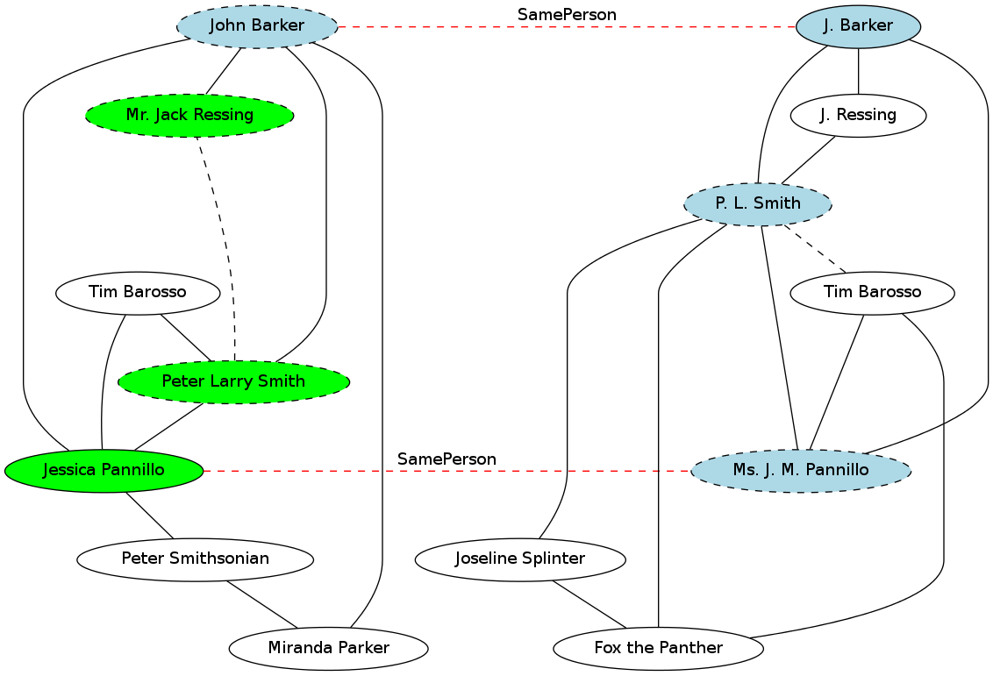
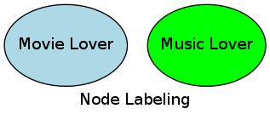
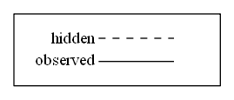
Relational Data (i.e., Graphs)

Slide 13
Probabilistic Soft Logic (PSL)
SRL Framework for compactly defining Markov network
Comes with methods for efficient probabilistic inference
PSL Model: Weighted First Order Logic (FOL) rule
If/then rules
See [Bach, Broecheler, Huang, & Getoor, 2017] for more on PSL.

Slide 14
PSL Example
head
body
$$0.3:votesFor\left(B,P\right)←friend\left(B,A\right) ∧ votesFor\left(A,P\right)$$
weight
predicate
variable

Slide 15

PSL Example
$$0.3:votesFor\left(B,P\right)←friend\left(B,A\right) ∧ votesFor\left(A,P\right)$$
grounding
$$votesFor\left(john,d\right)$$
Soft-truth value ϵ [0, 1]

Slide 16
PSL Inference
Input:
Weight PSL rules
Specification of
Query predicates
Evidence predicates
Data for evidence predicates
Output
Most probable assignment of truth value to query predicate (MPE inference)

Slide 17


Example: Waste Bins Management
R1
R2
80%
50%
60%
60%
B3
B4
B1
B2
R3
Where to send the truck to first?
80%
B5

Slide 18
The PSL Approach: Predicates
Predicates:
Bin(bid, loc)
IsFull(bid)
SendTruck(loc)
Evidence
Query

Slide 19
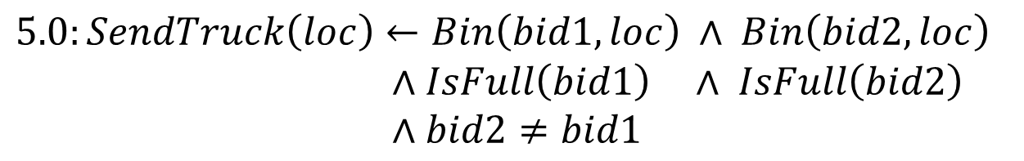

The PSL Approach: Rules
$$1.0:SendTruck\left(loc\right)←Bin\left(bid,loc\right) ∧IsFull(bid)$$
$5.0:SendTruck\left(loc\right)←Bin\left(bid1,loc\right) ∧ Bin\left(bid2,loc\right)$
$∧IsFull\left(bid1\right) ∧ IsFull\left(bid2\right)$
$∧bid2$ $≠bid1$
$$1.0:!SendTruck\left(loc\right)$$

Slide 20
The PSL Approach: Data
Bin(bid, loc)
Ground Predicate | Value
Bin(B1, R1) | 1
Bin(B2, R1) | 1
Bin(B3, R2) | 1
Bin(B4, R2) | 1
Bin(B5, R3) | 1
IsFull(bid)
Ground Predicate | Value
IsFull(B1) | 0.6
IsFull(B2) | 0.6
IsFull(B3) | 0.8
IsFull(B4) | 0.5
IsFull(B5) | 0.8
SendTruck(loc)
Ground Predicate | Value
SendTruck(R1) | ?
SendTruck(R2) | ?
SendTruck(R3) | ?
Queries
Evidence

Slide 21
The PSL Approach: First Results
R1
R2
80%
50%
60%
60%
B3
B4
B1
B2
SendTruck(loc)
Ground Predicate | Value
SendTruck(R2) | 0.43
SendTruck(R3) | 0.40
SendTruck(R1) | 0.39
R3
80%
B5

Slide 22
The PSL Approach: A modification
We want to give more emphasis to locations that are overall full.
$10.0:SendTruck\left(loc\right)←Bin\left(bid,loc\right) ∧IsFull(bid)$ $∧IsLocFull(loc)$

Slide 23
The PSL Approach: First Results
R1
R2
80%
50%
60%
60%
B3
B4
B1
B2
SendTruck(loc)
Ground Predicate | Value
SendTruck(R3) | 0.56
SendTruck(R2) | 0.44
SendTruck(R1) | 0.39
R3
80%
B5

Slide 24
Take-home Message
The IoT system are inherently uncertain
PSL is an SRL framework of probabilistic inference that deals with uncertainties
There is a potinal to using PSL on large scale IoT deployment
Personal Goal: Collaborate with IoT researchers.

Slide 25
References
Sun, Yunchuan, Houbing Song, Antonio J. Jara, and Rongfang Bie. 2016. “Internet of Things and Big Data Analytics for Smart and Connected Communities.” IEEE Access 4:766–73.
Jin, T., Wang, P. and Huang, Q. (2006) ‘A practical MTBF estimate for PCB design considering component and non-component failures’, in RAMS’06. Annual Reliability and Maintainability Symposium, 2006., pp. 604–610.
Schurgot, M. R., Shinberg, D. A. and Greenwald, L. G. (2015) ‘Experiments with security and privacy in IoT networks’, in 2015 IEEE 16th International Symposium on A World of Wireless, Mobile and Multimedia Networks (WoWMoM), pp. 1–6.
Getoor, L. and Taskar, B. (2007) Introduction to statistical relational learning. MIT press.
Domingos, P. (2012) ‘A Few Useful Things to Know About Machine Learning’, Commun. ACM. New York, NY, USA: ACM, 55(10), pp. 78–87. doi: 10.1145/2347736.2347755.

Slide 26
References Con’t
Bach, S. H., Broecheler, M., Huang, B., & Getoor, L. (2017). Hinge-Loss Markov Random Fields and Probabilistic Soft Logic. Journal of Machine Learning Research, 18(109), 1–67. Retrieved from http://jmlr.org/papers/v18/15-631.html

